Slide 1
HIV Prioritization tool Version 1
Anna Grimsrud 8 April 2021

Slide 2
Objective
To provide an interactive decision-support tool that helps stakeholders compare impact and budget trade-offs when prioritizing HIV services across the care cascade

Slide 3
Approach
Start with a ”version 1”:
Define core interventions across prevention, testing, and treatment
Estimate costs and impact on six key outcomes for each intervention: adult infections, infant infections, and the three 95s (diagnosis, treatment, viral suppression)
Build an interactive platform enabling users to adjust coverage levels and visualize resulting effects on outcomes and costs
Iterate based on user feedback, with potential expansion of intervention options in later versions

Slide 4
Backend
Each intervention in each of the prevention, testing, and treatment buckets affects how many people will land in a respective health state within a given year. The total number of people that end up in each health state directly impacts each of the outcomes assessed.
Key health outcome metrics measured:
Adult infections
Infant infections
Mortality
95 95 95 indicators
Some visual depiction here of the health states

Slide 5
What‘s Included: Prevention
 | Outcome affected
intervention | adult infections | infant infections | first 95 | second 95 | third 95 | mortality
PEP | X
Condom availability | X
PrEP (oral) | X
PrEP (Lenacapavir) | X
VMMC | X

Slide 6
What‘s Included: Testing
 | Outcome affected
intervention | adult infections | infant infections | first 95 | second 95 | third 95 | mortality
Testing: facility-based (general) |  |  | X | X | X
Testing: facility-based (targeted) |  |  | X | X | X
Testing: Network/Index |  |  | X | X | X
Testing: community-based |  |  | X | X | X
Testing: for key populations & STI services |  |  | X | X | X
HIVST (Facility-based) |  |  | X | X | X
HIVST (community-based) |  |  | X | X | X

Slide 7
What‘s Included: Treatment
 | Outcome affected
intervention | adult infections | infant infections | first 95 | second 95 | third 95 | mortality
ART provision for all | X |  |  | X | X | X
Differentiated service delivery (MMD, Community-pickup, fast-track) | X |  |  | X | X
Cotrimoxazole prophylaxis (according to guidelines) |  |  |  |  |  | X
ART initiation (and re-initiation) | X | X |  | X | X | X
VL monitoring: suspected failure | X |  |  |  | X | X
Routine VL monitoring | X |  |  |  | X | X
TB Screening and Treatment |  |  |  |  |  | X
TPT provision |  |  |  |  |  | X
AHD testing and prophylaxis package (LAM, CrAG, CD4, fluconazole) |  |  |  |  |  | X
Tracking & tracing (total) | X |  |  | X | X | X
Adherence Counselling/ psychosocial support | X |  |  | X | X | X

Slide 8
What‘s Included: ANC & PNC
 | Outcome affected
intervention | adult infections | infant infections | first 95 | second 95 | third 95 | mortality
Infant prophylaxis |  | X
ANC: HIV testing |  | X | X
EID (early infant diagnosis) |  |  | X |  |  | X
ANC: Viral Load Testing |  | X |  |  | X
PNC: HIV testing |  | X | X
PNC: Viral Load Testing |  | X |  |  | X
PNC: ART continuation | X | X |  | X | X | X

Slide 9
Requirements from users
For best results, it will be important to understand:
Epidemic context
Interventions in use in-country
Baseline coverage (or absolute number)of interventions
Interventions likely to alter in the future
Goal of HIV service re-prioritization (e.g maintain outcomes and budget, reduce budget with lowest impact on outcomes, improve outcomes within a certain budget change)
Feedback on components missing from the tool

Slide 10
Prototype HIV prioritization tool

Slide 11
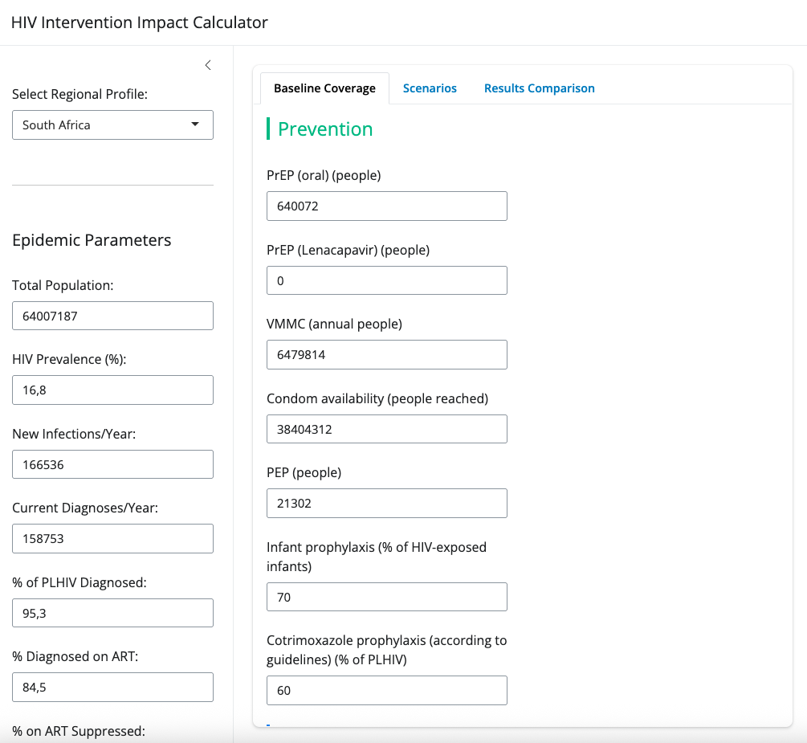
Choose context
1. Select country or choose a custom country
2. Confirm or edit epidemic parameters

Slide 12
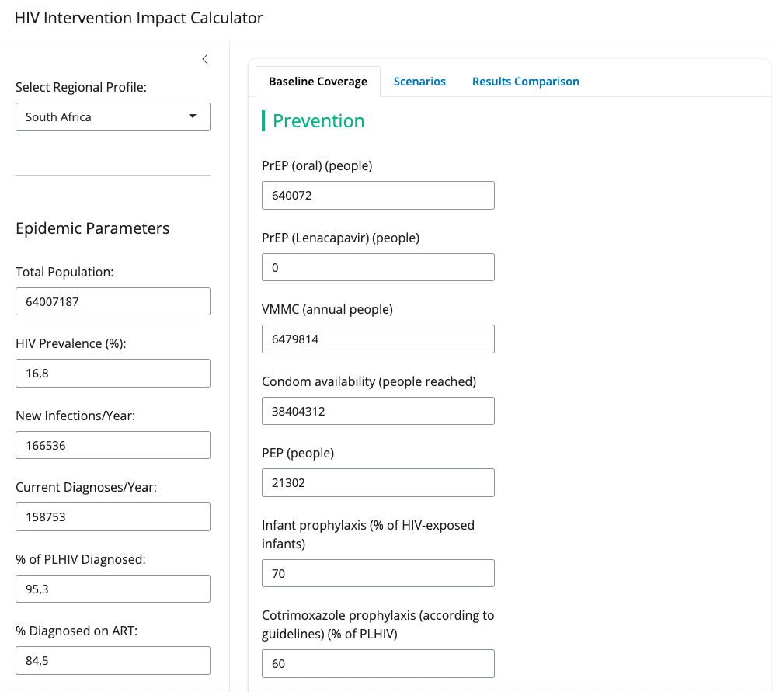
Populate baseline interventions

Slide 13
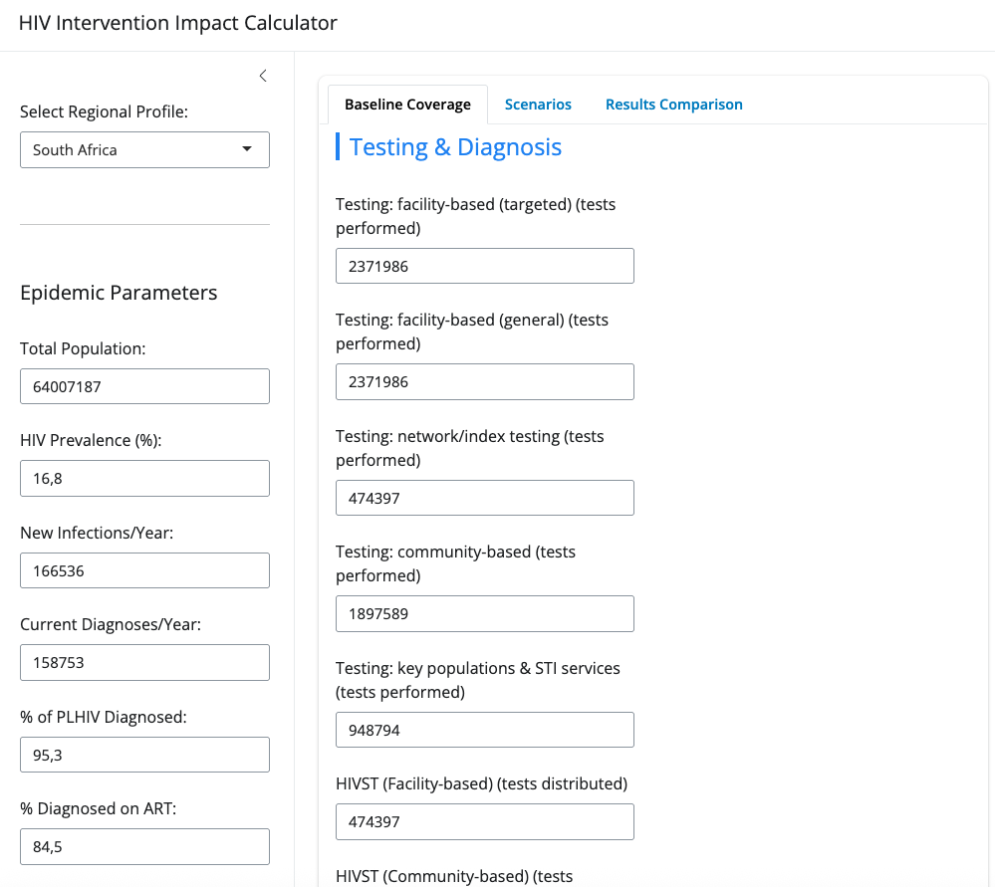
Populate baseline interventions

Slide 14
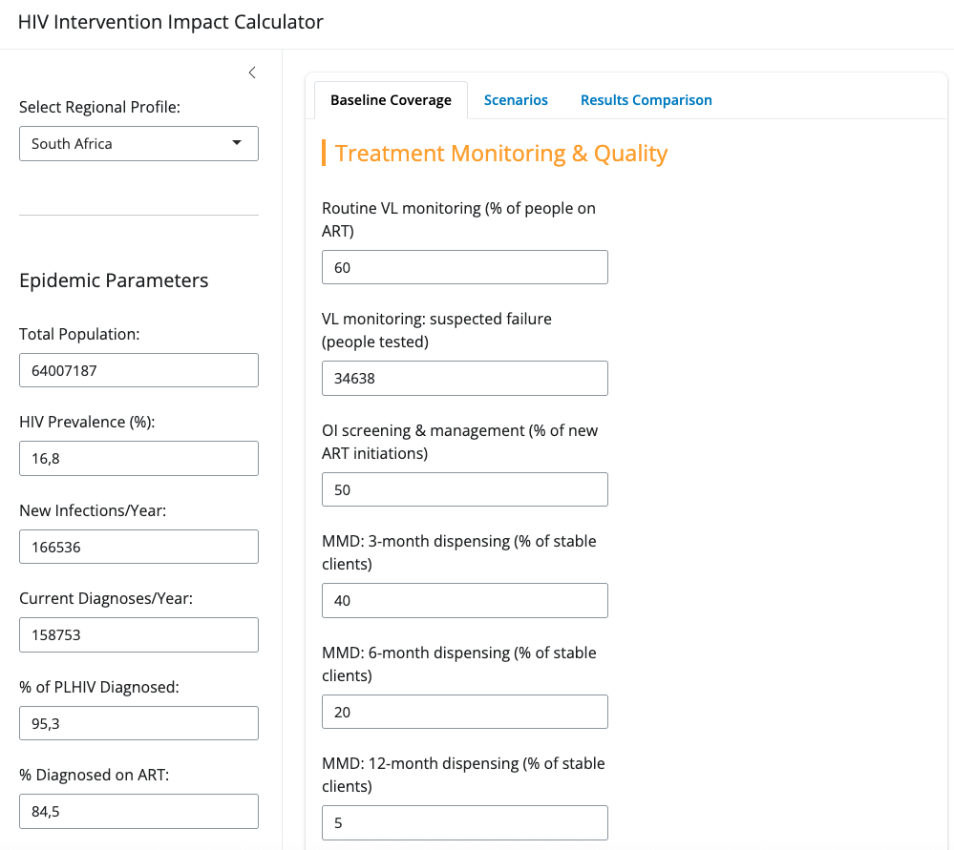
Populate baseline interventions

Slide 15
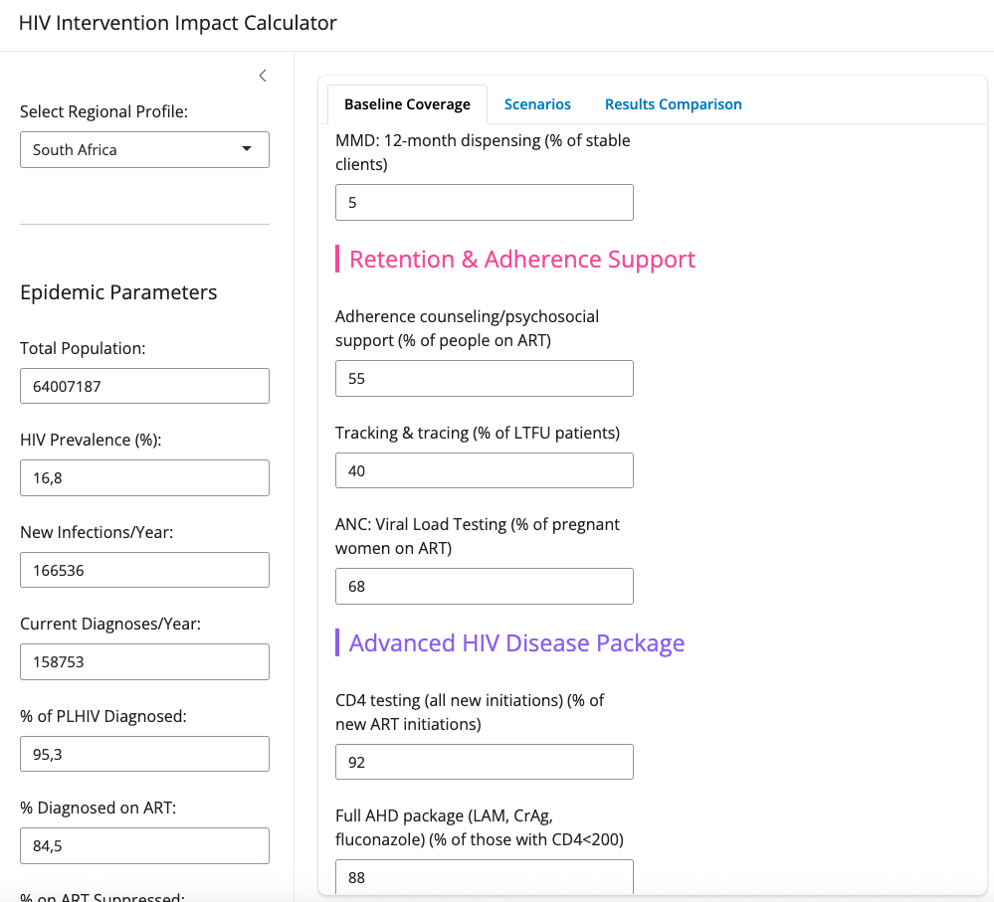
Populate baseline interventions

Slide 16
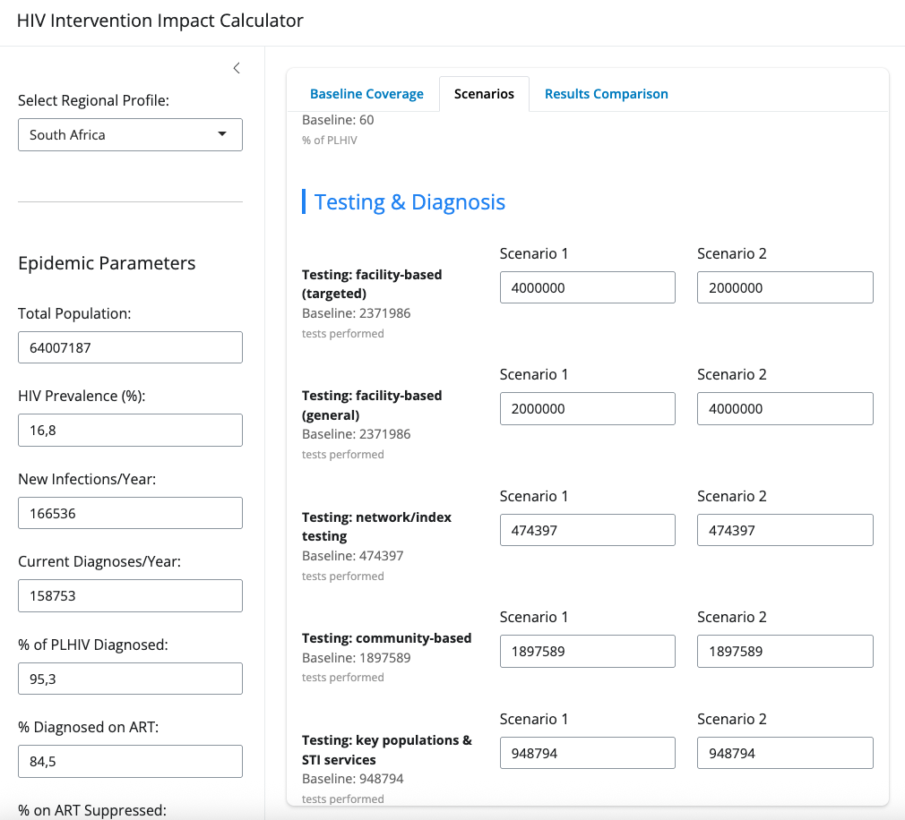
Populate scenarios for comparison
Adapt coverage of interventions across all categories of interest
Testing example pictured

Slide 17
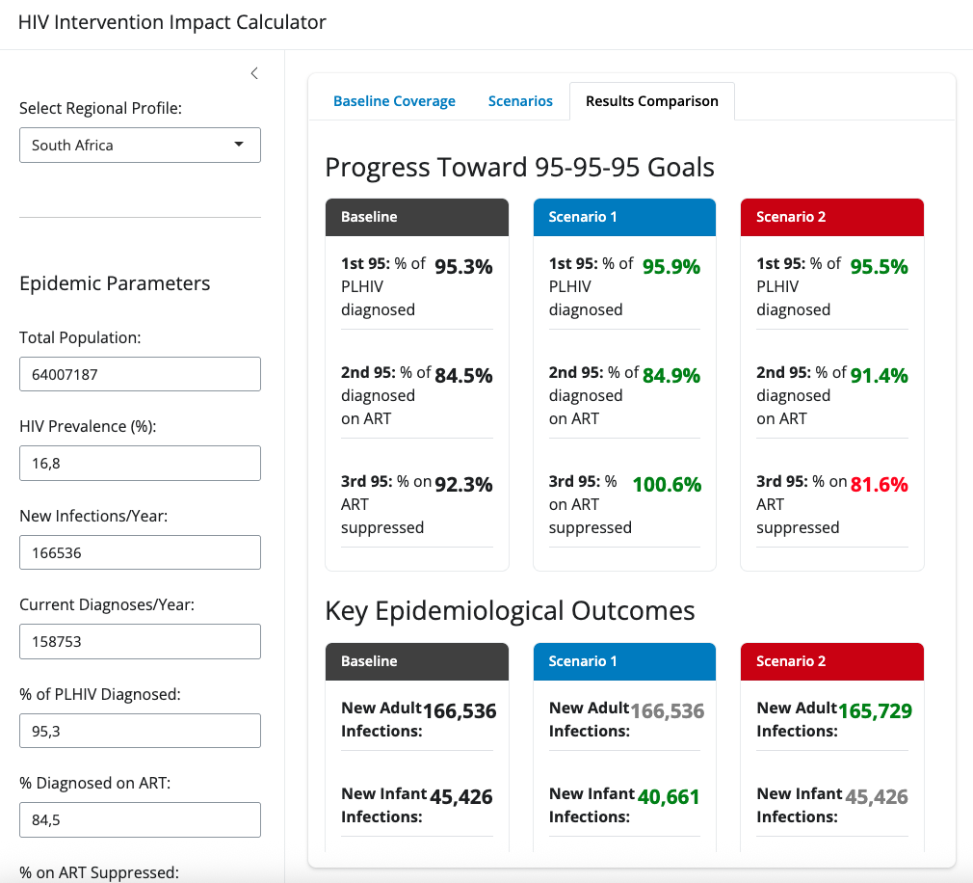
Compare costs and outcomes
Based on all intervention changes - prevention, testing and treatment- consider impact on outcomes

Slide 18
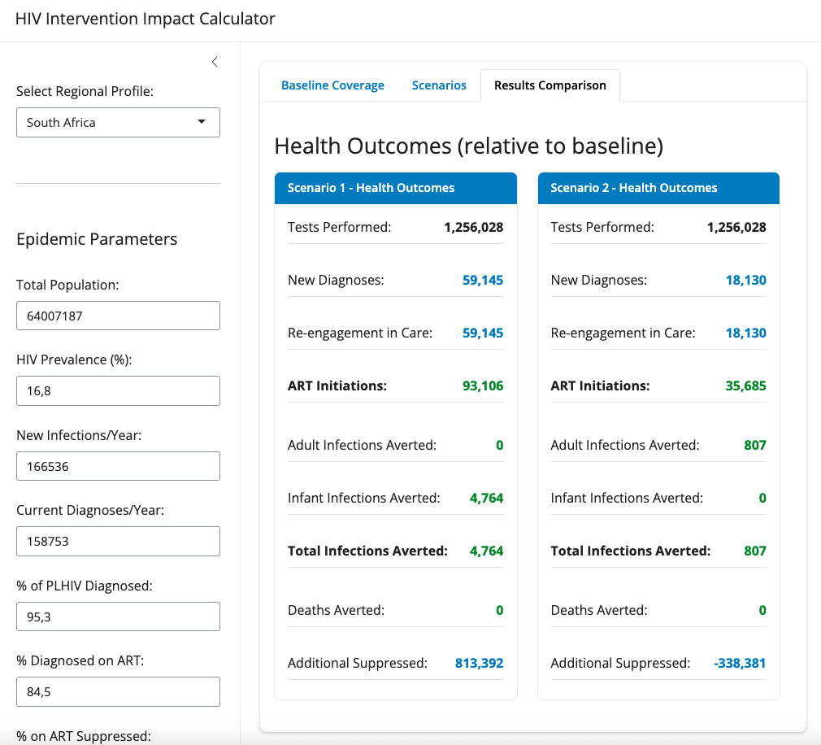
Compare costs and outcomes
Based on all intervention changes - prevention, testing and treatment- consider impact on outcomes

Slide 19
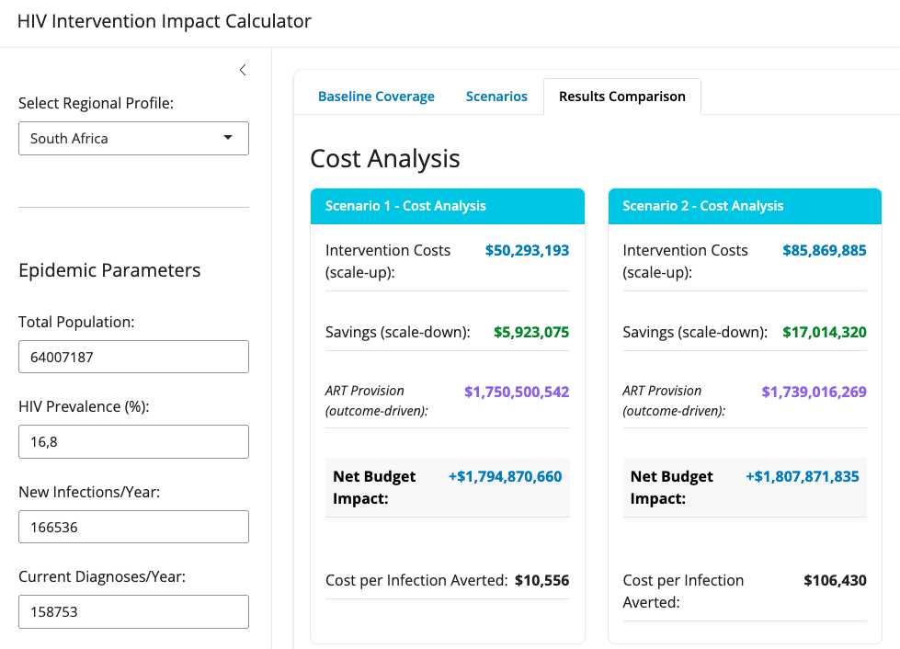
Compare costs and outcomes
Based on all intervention changes - prevention, testing and treatment- consider impact on outcomes

Slide 20
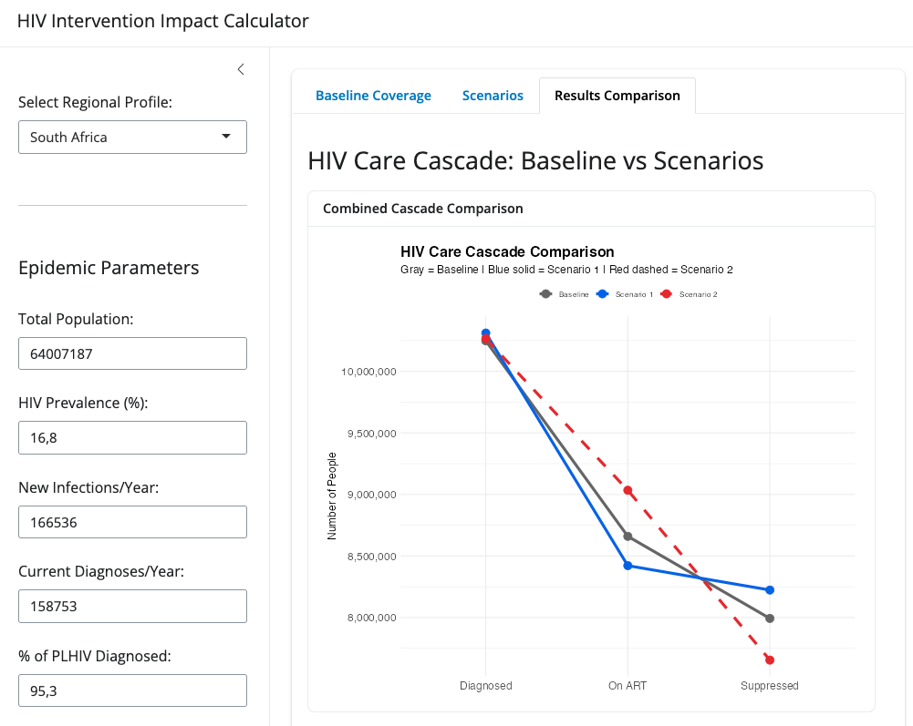
Compare costs and outcomes
Based on all intervention changes - prevention, testing and treatment- consider impact on outcomes

Slide 21
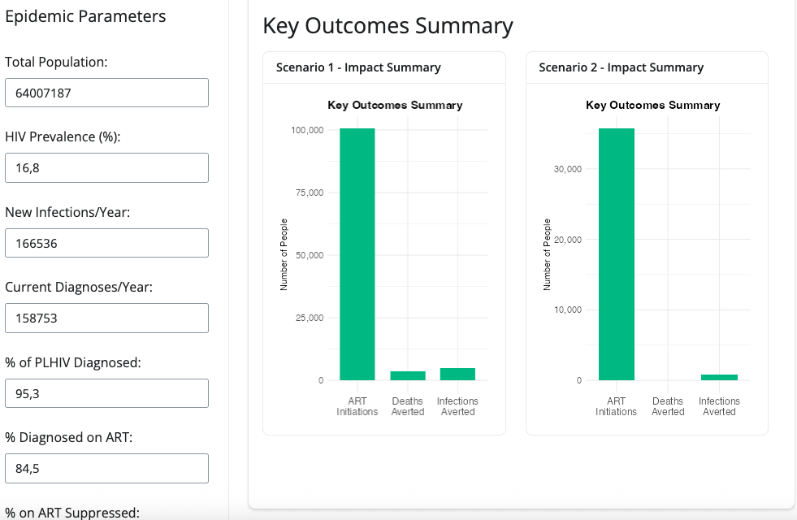
Compare costs and outcomes
Based on all intervention changes - prevention, testing and treatment- consider impact on outcomes

